Slide 1

COMPILER DESIGN
Report summary
Kareen Ziadat

Slide 2
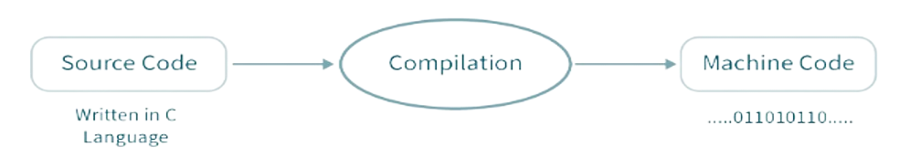

The compiler
A compiler is a software tool that converts high-level programming code written in a source language into machine code or intermediate code that a computer can execute. The method consists of numerous steps, including lexical analysis, syntax analysis, semantic analysis, code optimization, and code generation, which will be discussed more.
Notes:
Definition
A compiler is a software tool that converts high-level programming code written in a source language into machine code or intermediate code that a computer can execute. The method consists of numerous steps, including lexical analysis, syntax analysis, semantic analysis, code optimization, and code generation, which will be discussed more.
Role
The compiler's job is to turn a program's whole source code into an executable file that can then be run on a specific computer architecture.
Practical example
Say you've written a story (your program) in English (a high-level programming language), that you would like to explain to someone who only understands Arabic (the machine code). For the other person (the computer) to be able to read your story, you will need to translate it. In this case, the compiler functions as a translator, taking your story (program) and translating it into Arabic (machine code).

Slide 3
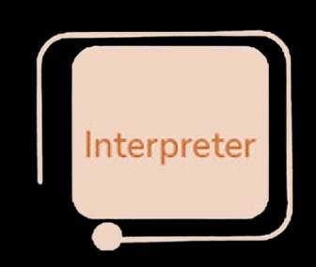
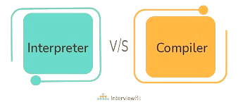
Compiler vs Interpreter vs Hybrid
Hybrid
Notes:
Language Processor: Compiler
Function:
- Converts high-level language code to machine code.
- Produces executable file by compiling entire code at once.
Advantages:
1. Faster execution post-compilation (no real-time translation needed).
2. Less resource consumption during runtime.
3. Enhanced error detection at compile time (catches syntax, type, and semantic errors).
Disadvantages:
1. Slower initial compilation process.
2. Requires recompiling for any code modification.
3. Delayed error detection in large programs.
Use Cases:
- Ideal for large-scale, high-performance applications (e.g., system software, game development).
- Predominantly used in low-level languages like C, C++.
- Example: C language is processed using compilers like GCC and Clang, converting code to machine code saved as executable files.
Parser Function of Interpreter
Reads and executes code line by line.
Translates each line of source code into operations for the computer.
Executes processes and uses run-time data inputs.
Translates and executes each line progressively.
Contrast with Compiler: Interpreter handles code line by line, while Compiler translates entire program before execution.
Advantages of Interpreters
Error Detection: Easier error detection and correction due to line-by-line execution.
Speed of Start: Faster program start compared to compilers.
Rapid Modification: Allows immediate code changes and testing without recompilation.
Cross-Platform Compatibility: Can execute on any machine with the appropriate interpreter.
Disadvantages of Interpreters
Execution Speed: Slower execution as each line is read, interpreted, and executed.
Resource Usage: Higher resource consumption during execution.
Runtime Error Detection: Inefficient for identifying certain errors, as problems are discovered at runtime.
Dependency: Requires the target machine to have the necessary interpreter installed.
Use Cases
Ideal for development and testing environments.
Suitable for scripting that requires rapid testing and feedback.
Common in high-level languages like Python and Ruby, executing instructions immediately.
Example: CPython for Python, written in C.
hybrid How it Works:
Java employs a hybrid approach, combining a compiler and an interpreter with Just-In-Time (JIT) compilation.
Java code is first compiled by the Java compiler (javac) into bytecode, a platform-independent intermediate form.
The bytecode runs on any machine with a Java Virtual Machine (JVM), embodying Java's "write once, run anywhere" philosophy.
JVM, being platform-dependent, exists in various versions for different operating systems.
Within JVM, an interpreter executes the bytecode line by line, converting it to machine code.
The JIT Compiler, a JVM component, optimizes performance by compiling frequently called bytecode parts into machine code at runtime.
Advantages:
Platform Independence: Bytecode allows Java programs to run on any JVM-equipped machine.
Efficiency: JIT compiler enhances performance by converting often-used bytecode to machine code during runtime.
Instant Execution: Interpreting bytecode line by line lets the system run code without waiting for complete compilation.
Disadvantages:
Initial Delay: JIT compilation can slow down the first execution, impacting short-running applications.
Memory Usage: JIT compilers require more memory as they store both source bytecode and generated machine code.
Overhead: JIT compilation involves complex algorithms to optimize code compilation.
Use Cases:
JIT compilation is utilized in Java, JavaScript, WebAssembly.
Ideal for server-side programs (e.g., web and application servers) to manage heavy loads.
Suitable for cross-platform applications (Windows, macOS, Linux) without source code modification.

Slide 4
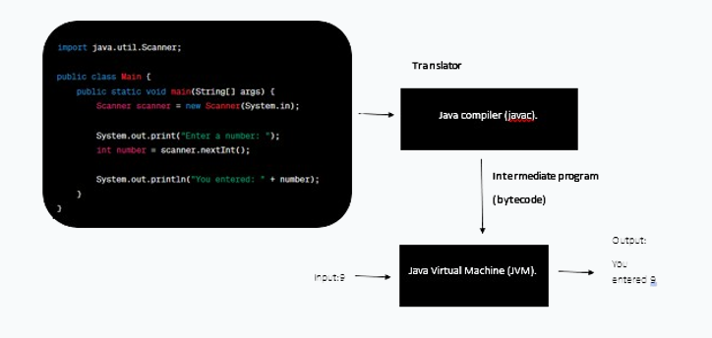
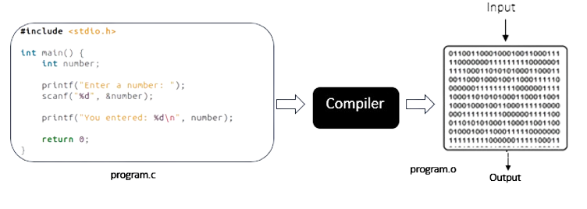
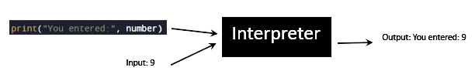
Compiler vs Interpreter examples
Notes:
This source code is passed into a compiler, which checks it for syntax mistakes and then creates an object file or executable if none are discovered. The compilation process produces a file containing machine code, which is low-level code that may be run directly by the computer's CPU. When the software is launched in this case, it will prompt the user to enter a number, which it will then read and show to the user.
Let’s look at the example. Here is the same source program written in python: It processes line 1 number = int(input("Enter a number: ")), which instructs the interpreter to show the string "Enter a number:" and wait for the user to input a number. When a number is entered by the user, the interpreter converts it to an integer and stores it in the variable number. The interpreter then performs the second line of code, which is print("You entered:", number). This line displays the words "You entered:" followed by the number entered by the user.

Slide 5
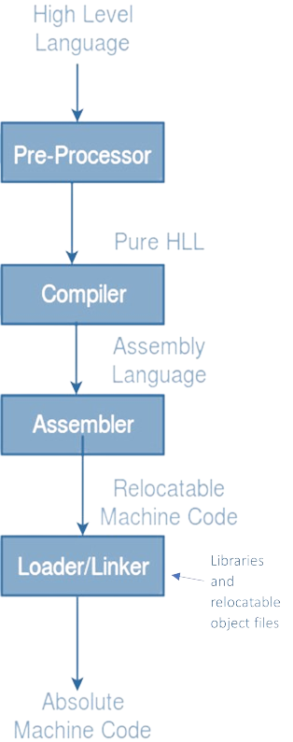
Compiler in the program execution process
Notes:
Pre-processor Phase:
Processes High-Level Language (HLL) code.
Handles directives like #include and #define.
Replaces #include with actual file contents.
Outputs "pure" HLL code, free from pre-processor directives.
Compiler Phase:
Transforms "pure" HLL code into assembly language.
Involves several steps: a. Lexical Analysis: Breaks code into tokens. b. Syntax Analysis: Organizes tokens into syntax tree. c. Semantic Analysis: Ensures logical consistency. d. Optimization: Refines code. e. Code Generation: Produces assembly language code.
Assembler Phase:
Converts assembly code to relocatable machine code.
Acts as an intermediate step between HLL and machine code.
Linker/Loader Phase:
Processes relocatable machine code.
Integrates libraries and resolves address references.
Produces absolute machine code file (executable).
Final Output:
Executable machine code in binary format.
Ready for immediate execution by the computer's CPU.

Slide 6
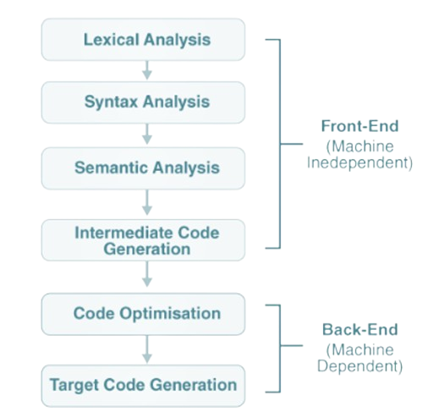
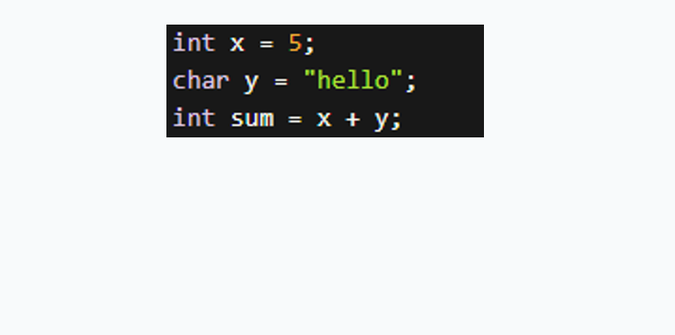
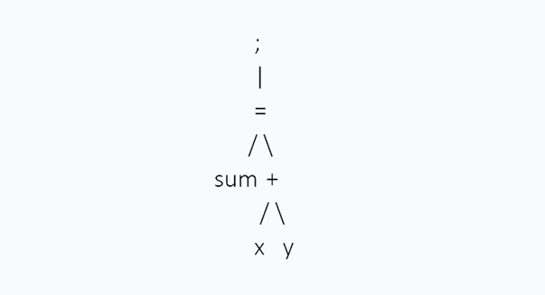
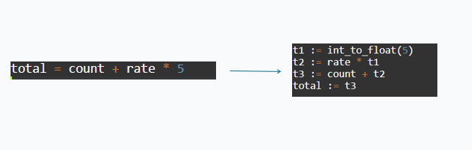

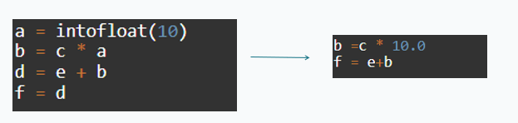

Internal phases of compilation process
int | x | = | 5 | ; | char | y | = | hello | ; | int | sum | = | x | + | y | ;
Notes:
Now lets zoom into the phases within the compiler Two Main Parts of Compilation
Analysis (Front End):
Breaks down source program into tree structure.
Machine independent process.
Synthesis (Back End):
Translates tree structure into target program.
Machine dependent process.
Internal Phases of Compilation
Lexical Analyzer:
First phase; processes source code into tokens.
Recognizes lexemes, forms tokens, creates symbol table.
Syntax Analyzer:
Parses tokens based on grammar, forms parse/AST.
Semantic Analyzer:
Ensures semantic consistency using AST and symbol table.
Checks type mismatches, variable declarations, array bounds.
Intermediate Code Generation:
Generates machine-independent intermediate code.
Code Optimization:
Enhances efficiency and speed of executable.
Involves deleting redundant code, reorganizing statements.
Code Generation:
Translates optimized code into machine code.
Allocates memory for variables.
Lets look at an example Let’s assume we have this source code snippet:
The analyzer would identify the following tokens (keywords, operators, identifiers): Splitting the source code into tokens allows parsing and semantic analysis to work with a structured representation of the program, which aids understanding and translation of the code into executable instructions. Tokens are passed to a syntax analyzer, which analyzes them based on the language grammar and organizes them into a hierarchical structure, often represented as a parse or an abstract syntax tree (AST) if the syntax is correct. This ensures that the source code satisfies the programming language's grammatical rules. Ex. This line of the code Will generate this AST:
It uses the syntax tree from the previous phase, as well as the symbol table from the lexical analyzer and examines the relationships between the AST's elements to ensure that the given source code is semantically consistent. The Semantic Analyzer will look for type mismatches, incompatible operands, scope analysis, an undeclared variable, and so on.
Examples:
Type mismatch: The operands in an expression must be compatible with the operator being used. In an arithmetic operation, such as addition (+), the operands on both sides must be of compatible type, such as both integers or floating-point values.
Variable declaration: If you want to use the variable x in your program, you must declare it first, as in int x; similarly, you can’t use a function without declaring it first.
Array bound checking: Array access must be within the array's limits. So, if you declare an array int arr[5];, you can only access elements between arr[0] and arr[4]. Accessing arr[5] or above would result in unpredictable behavior.

Slide 7
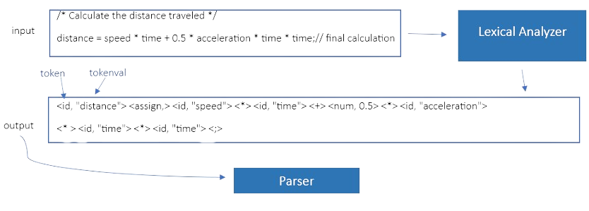

The lexical analyzer
Notes:
An even closer look into the lexical analyzer Role:
Input: Raw program source code (characters, numbers, symbols, whitespace).
Output: Stream of tokens for the parser (syntax analyzer).
Process:
Scanning:
Delete comments.
Compact whitespace.
Tokenization:
Pattern matching using regular expressions.
Token creation.
Symbol table entries (identifiers, literals).
Data Structures and Techniques:
Transition Table: For DFA in token recognition.
Buffers: Double buffering for lookahead and efficient data flow.
Hash Tables: Storing tokens and symbol-table records.
Techniques: Regular expressions to DFA, hand-coding, buffer management, error handling.
Advantages:
Speed in processing source code.
Simplifies parsing by breaking input into tokens.
Flexibility in language development.
Early error detection.
Potential code optimization.
Disadvantages:
Complexity in implementation.
Limited scope of error detection.
Increased code size.
Maintenance challenges with syntax changes.
Why Separate from Other Phases:
Modularity: Efficient, independent debugging and testing.
Simplicity and Efficiency in Parsing: Streamlines the parsing process.
Optimization: Tailored for reading input text.
Portability and Reusability: Independent of specific language syntax.
Error Handling: Focused management of character and token formation errors.

Slide 8
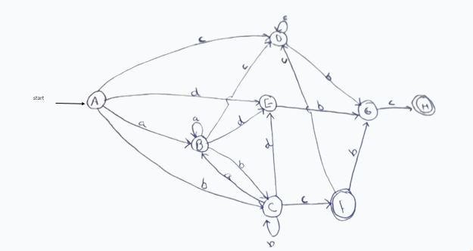
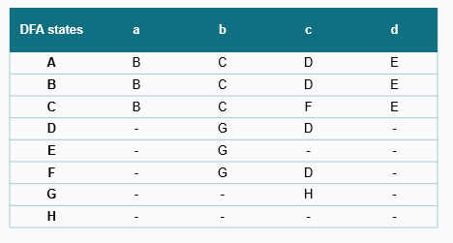
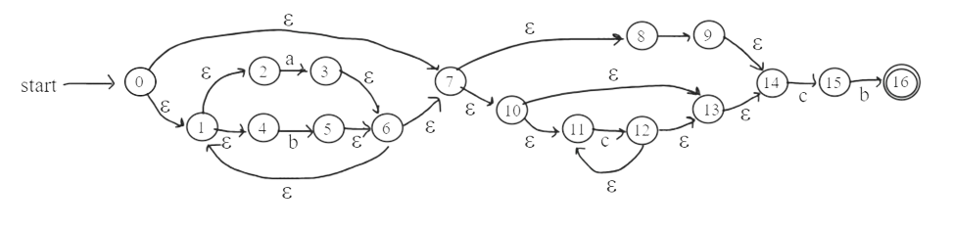
Conversion between RE-NFA-DFA
RE: (a|b)*(d|c*)bc
For each DFA state, each input (a,b) determine NFA states reachable and find e-closure (move, e-closure functions)
Identify DFA states, accept states.

Slide 9
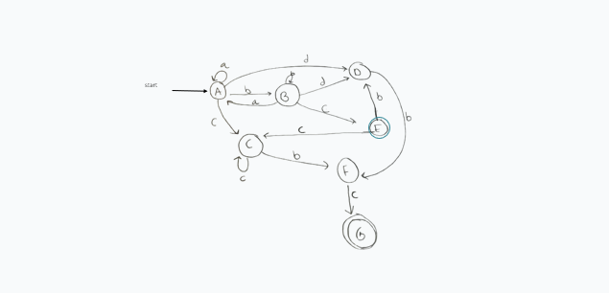
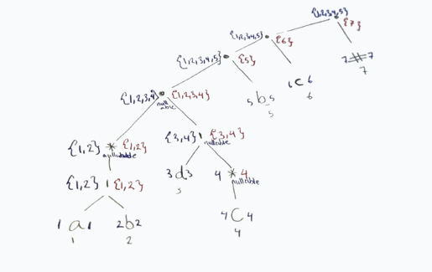
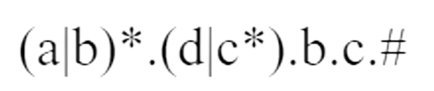
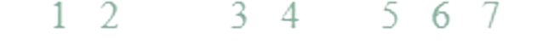
Conversion between RE-DFA
DFA | a | b | c | d
A = {1,2,3,4,5} | {1,2,3,4,5} = A | {1,2,3,4,5,6} = B | {4,5} = C | {5} = D
B={1,2,3,4,5,6} | {1,2,3,4,5} = A | {1,2,3,4,5,6} = B | {4,5,7} = E | {5} = D
C={4,5} | - | {6} = F | {4,5} = C | -
D={5} | - | {6} = F | - | -
E={4,5,7} final | - | {5} = D | {4,5} = C | -
F={6} | - | - | {7} = G | -
G={7} final | - | - | - | -
RE: (a|b)*(d|c*)bc
 | Node | Follow position
a | 1 | {1,2,3,4,5}
b | 2 | {1,2,3,4,5}
d | 3 | {5}
c | 4 | {4,5}
b | 5 | {6}
c | 6 | {7}
# | 7 | {}

Slide 10
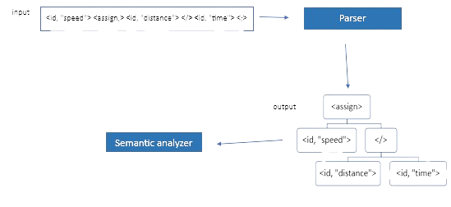

The syntax analyzer
Notes:
Parser's Function
Input: Receives token string from lexical analyzer.
Processes:
Verifies token string against source language's grammar.
Reports syntax errors and handles them.
Constructs parse tree (top-down or bottom-up approach).
Additional Tasks
Stores token information in symbol table.
Performs type checking.
Generates intermediate representation (IR), e.g., ASTs, CFGs.
Output
Produces AST or another IR for subsequent compiler phases (semantic analysis or code generation).
Data Structures and Techniques
Utilizes parse trees, ASTs, stacks, parsing tables, symbol table.
Employs top-down (Recursive descent, LL) and bottom-up (LR, SLR, LALR, CLR) parsing techniques.
Implements error recovery and symbol table management.
Advantages
Enhances error detection, code structure, optimization potential, translation ease, and semantic analysis.
Disadvantages
Complexity in design, performance concerns, error recovery challenges, maintenance, and handling grammar ambiguities.
Separation from Other Compiler Phases
Ensures modularity, abstraction, reusability, efficiency in error resolution, parallel development, focused testing, reduced complication, and independent grammar modification.

Slide 11
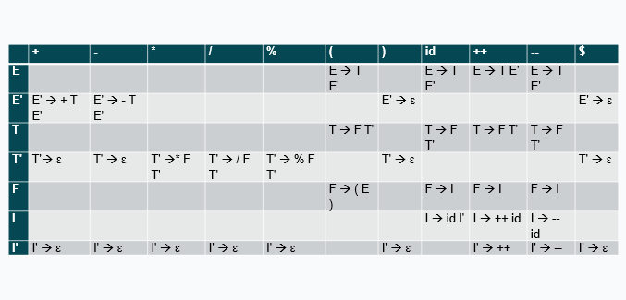
Relationship between parser and grammar
Non-terminal | First | Follow
E | {(,id,++,--} | {$,)}
E’ | {+,-, ε} | {$,)}
T | {(,id,++,--} | {+,-,$,)}
T’ | {*,/,%, ε} | {+,-,$,)}
F | {(,id,++,--} | {*,/,%,+,-,$,)}
I | {id,++,--} | {*,/,%,+,-,$,)}
I’ | {++,--, ε} | {*,/,%,+,-,$,)}
Stack | Input | Production Rule
$ E | ( id ) $
$ E' T | ( id ) $ | E → T E'
$ E' T' F | ( id ) $ | T → F T'
$ E' T' ) E ( | ( id ) $ | F → ( E )
$ E' T' ) E | id ) $ | POP MATCH
$ E' T' ) E' T | id ) $ | E → T E'
$ E' T' ) E' T' F | id ) $ | T → F T'
$ E' T' ) E' T' I | id ) $ | F → I
$ E' T' ) E' T' I' id | id ) $ | I → id I'
$ E' T' ) E' T' I' | ) $ | POP MATCH
$ E' T' ) E' T' | ) $ | I' → ε
$ E' T' ) E' | ) $ | T' → ε
$ E' T' ) | ) $ | E' → ε
$ E' T' | $ | POP MATCH
$ E' | $ | T' → ε
$ | $ | E' → ε
ACCEPTED
E → E + T | E - T | T
T → T * F | T / F | T % F | F
F → ( E ) | I
I → id | id ++ | id -- | ++ id | -- id
Eliminate left recursion
E → T E'
E' → + T E' | - T E' | ε
T → F T'
T' → * F T' | / F T' | % F T' | ε
F → ( E ) | I
I → id | id ++ | id -- | ++ id | -- id
Eliminate left factoring
E → T E'
E' → + T E' | - T E' | ε
T → F T'
T' → * F T' | / F T' | % F T' | ε
F → ( E ) | I
I → id I' | ++ id | -- id
I' → ++ | -- | ε

Slide 12
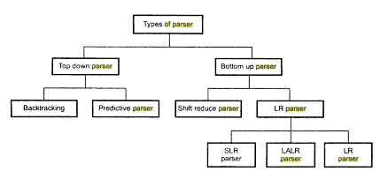
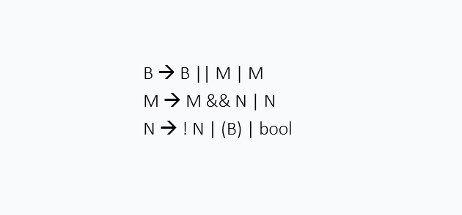
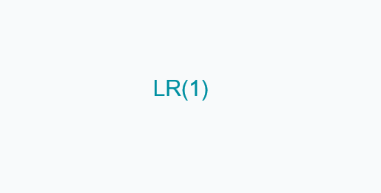

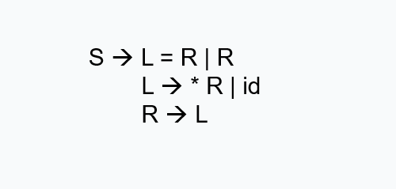

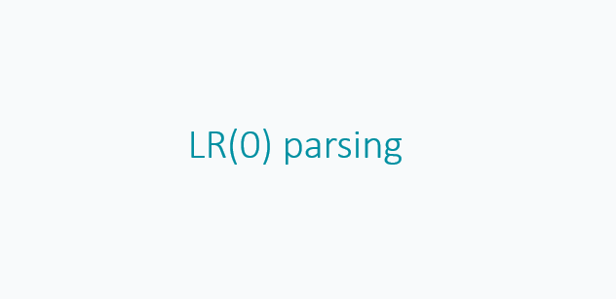
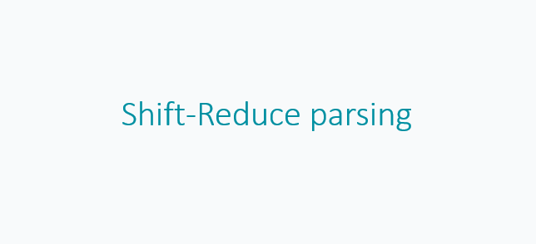

Techniques to build parser
Notes:
Grammar in Parser Design
Definition: Grammar in a programming language is a set of rules for writing correct statements. It is expressed using context-free grammars (CFGs).
Components of CFG: CFG is represented as a 4-tuple �={�,�,�,�}G={N,T,P,S}, where:
�N: Finite set of nonterminal symbols.
�T: Finite set of tokens (terminals).
�P: Finite set of production rules (�→�α→β).
�S: Start symbol, belonging to non-terminals.
Role in Parsing: Grammar acts as a blueprint for parsers to identify valid code and construct parse trees, understanding the elements and their relationships.
Parsing Techniques
Top-Down Parsing:
Begins with the highest-level rule, constructing parse trees from the root.
Types:
Recursive Descent: Brute force, backtracking parser, suitable for simple grammars but struggles with left-recursive grammars and complex grammars.
Non-Recursive Descent (LL Parsing): Scans input left to right, uses lookahead tokens, and a parsing table. More efficient but cannot handle left-recursive grammars without transformation.
Bottom-Up Parsing:
Constructs parse trees from input symbols, applying reverse of rightmost derivation.
Types:
Shift-Reduce Parsing: Involves shifting symbols to a stack and reducing them. Can handle a wider range of grammars but is more complex.
LR Parsing: Advanced form of shift-reduce parsing, reads input left to right, handles a wide range of grammars efficiently. Variations include SLR, LR(1), LALR, and CLR.
Comparison Through Example:
Demonstrated using a grammar for logical operations in C.
LL(1) Parsing: Faces issues with left recursion and requires grammar restructuring. Limited in handling complex grammars.
Shift-Reduce Parsing: Handles left recursion better but prone to parsing conflicts.
LR(0) and SLR Parsing: More robust, handles ambiguities and complexities better. SLR improves upon LR(0) by using follow sets for non-terminals.
LR(1) and LALR Parsing: LR(1) uses lookahead tokens to resolve conflicts, LALR reduces complexity while maintaining advantages.

Slide 13
Code generation
ICG Graphical representations:
Syntax tree
DAG
Postfix notation
TAC
Quadruples
Triples
Indirect Triples
Static Single Assignment (SSA).
Notes:
Intermediate Code Generation
Graphical Representations:
Syntax Trees: Break down code into its grammatical components.
Directed Acyclic Graphs (DAGs): Compact form to optimize code by detecting common subexpressions, reducing duplicate calculations.
Example of DAGs benefit: Minimizes the number of registers needed, optimizing CPU usage.
Techniques in Code Generation
Postfix Notation: Linearized syntax tree. Streamlines parsing, especially for stack-based computers.
Example: a := b/c * b/c in postfix is a bc/ bc/ * assign.
Three-Address Code (TAC): Divides expressions into multiple instructions for simpler translation to assembly language. Enhances readability and optimization.
Example: a := b/c * b/c in TAC might be t1 := b/c; a := t1 * t1.
Data Structures for Code Generation
Quadruples: Consists of op, arg1, arg2, and result. Efficient for representing operations.
Triples: Include op, arg1, and arg2. Removes need for temporary variables.
Indirect Triples: List of pointers to triples for more flexible code modifications.
Static Single Assignment (SSA): Each variable is allocated once, simplifying compiler optimizations.

Slide 14
Code Optimization
A control flow graph (CFG) is a visual tool that depicts the flow of a program's execution. It is made up of
basic blocks, which are code units that contain a sequence of instructions.
Common-Subexpression Elimination (CSE)
Dead Code Elimination
Renaming Temporary Variables
Statement Interchange
Efficient Register Allocation
Graph coloring and live variable analysis
Peephole Optimization
Algebraic Transformations
Local Code Optimizations
Constant folding, constant combining, strength reduction, constant propagation sends the values of known constants to their usage sites in the code, common subexpression elimination, and backward copy propagation by replacing variables with their values .
Global Code Optimizations
Dead code elimination, CSE, constant propagation, . Forward copy propagation, Code motion (remove code from loop, .loop strength reduction induction variable elimination
Notes:
Control Flow Graph (CFG)
Visual representation of program execution flow.
Comprised of basic blocks for clear visualization of execution paths.
Optimization Techniques
Common-Subexpression Elimination (CSE): Replaces multiple instances of the same expression with a single computation.
Dead Code Elimination: Removes non-impacting code.
Renaming Temporary Variables: Reuses storage spaces, optimizing memory use.
Statement Interchange: Rearranges independent statements for better execution flow.
Efficient Register Allocation: Utilizes graph coloring and live variable analysis for optimal register use.
Peephole Optimization: Improves machine code sequences.
Algebraic Transformations: Simplifies expressions to less expensive equivalents.
Local Code Optimizations: Includes constant folding, combining, strength reduction, and propagation.
Global Code Optimizations: Advanced techniques like dead code elimination, constant propagation, and loop optimizations.
Benefits of Efficient Register Use
Enhances processor resource efficiency.
Reduces need for slower memory accesses.
Improves code scalability and adaptability to different processors.

Slide 15
THANK YOU!

